Slide 1
PPL PROJECT
MULTILINGUAL TWITTER SENTIMENT ANALYSIS
UNDER GUIDANCE OF PROF.KHATAVKAR SIR
BY
MOHIT BAVISKAR - 111803148
PRATIK DESAI – 11180153
SARVESH BODHAKE - 111803149

Slide 2
REASON FOR SELECTING PROJECT ???
Currently, whole world is facing the problem of CORONA pandemic.
It has not only affected our physical state,
but due to social distancing, it has also created a threat for our mental health.
So, people are using social media for expressing their feelings and their views on the current situations and government measures taken for preventing Corona.
So, in this project we are doing a social media analysis in order to understand people’s view.
Aim of these project is to get an insight of people’s response towards government policies and present situation.

Slide 3
This pandemic has affected the European continent in the worst way possible
So, we decided to do our research on all European countries.
The news channel usually don’t not focus on everyones opinion. So as to generalize what exactly is the situation we decided use social media applications like twitter.
What exactly are the views of the people in a specific country, how are they dealing with this crisis are some of the questions we have tackled in this project.

Slide 4
WHY TWITTER ?
We have chosen to work with twitter since we feel it is a better approximation of public sentiment as opposed to conventional internet articles and web blogs.
Much Relevant Info as compared to other blogging sites
The response on twitter is more prompt and also more general.
Almost Live Updates can be taken using twitter
Exact situation of a area could be determined almost instantly.
Twitter has almost 200 million users out of which 100 million are active ones with almost half of them log on daily basis.
250 million tweets are approximated everyday.
Just by using right methods and techniques one can easily find out about anything in the world that’s been going on like this recent pandemic.

Slide 5
Using tweepy.cursor()
def get_tweets(keyword, num_tweets=500):
tweets = tweepy.Cursor(api.search, q=keeyword, lang=‘en’,).items(num_tweets)
return tweets
Tweet Object Attributes:
id
text
user 🡪 id, location=“Pune”, lang=“hi”
coordinates
Place 🡪 coordinates, country=“India”, country_code=“In”, name=“Mumbai”, place_type(city/ rural)-”city”
entities 🡪 hashtags, user_mentions, symbols
retweeted
Lang
DataFrame : Columns = [ ‘text’, ‘lang’, ‘user_location’, ‘coordinates’, ‘place’, ‘country’, ‘country_code’,‘place_type’, ‘symbols’]

Slide 6
Translation Of Texts
After processing of text
Google Translator :
From googletrans import translator
translator = Translator()
text = translator.translate(tweet.text, dest=‘en’, src=‘es’)

Slide 7
CODE FOR DATA COLLECTION -using twitterscraper
from twitterscraper import query_tweets
import datetime as dt
import pandas as pd
begin_date = dt.date(2020,1,1)
end_date = dt.date(2020,5,14)
limit = 5000
lang = 'nl'
tweets = query_tweets("corona belgium",begindate=begin_date,enddate=end_date,limit=limit,lang = lang)
df = pd.DataFrame(t.__dict__ for t in tweets)
df.to_csv('Belgium.csv’)
Using this above code to collect all the data in a particular language and then filtering outh the data through geotags for particular countries

Slide 8
Text preprocessing
First we removed twitter handles, small words, numbers, and other unnecessary stuff.
Then we replaced this with spaces.
Then we performed tokenization for normal stemming using PorterStemmer.
At last, we also did little analysis of hashtags using hastaaaaa

Slide 9
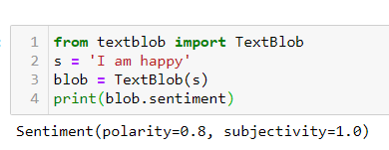
TEXTBLOB
TextBlob is a python library and offers a simple API to access its methods and perform basic NLP tasks.
A good thing about TextBlob is that they are just like python strings. So, you can transform and play with it same like we did in python.

Slide 10
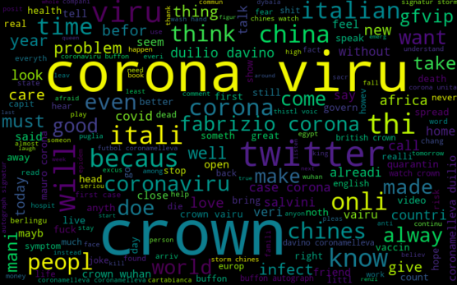
DATA VISUALIZATION
We used matplotlib for data visualization.
We used wordcloud for showing most used words.

Slide 11
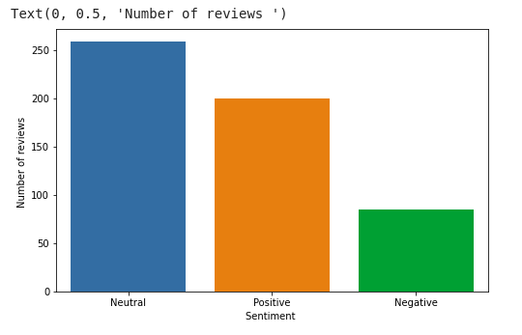
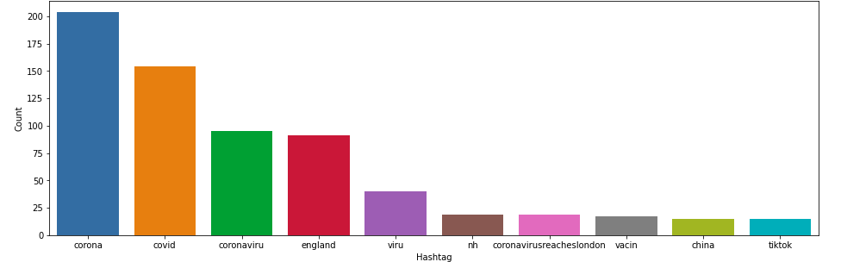
We used bar graphs for showing hash tags and amount of positive, negative and neutral tweets.

